Slide 1

KNOCKTURN WEBSITE
Empowering Growth Through Property, Manpower & Projects
Done by:
JYOTHSNA PRIYA
REBECA SUJI
DURGA DEVI
Special Thanks and Guidance by:Sam Prakash and Leo Celestine Sir

Slide 2
ABOUT KNOCKTURN
COMPANY OVERVIEW
VISION & MISSION
KnockTurn is a comprehensive digital platform revolutionizing the real estate and business services industry. We provide seamless integration of property management, project listings, and manpower solutions all in one unified ecosystem.
Vision: To be the leading integrated platform connecting properties, products, and people, transforming how businesses manage their resources.
Mission: To deliver innovative, user-friendly solutions that simplify property management, streamline product distribution, and connect skilled manpower with opportunities.
Our innovative approach combines cutting-edge technology with practical business needs, making it easier for clients to manage diverse assets and resources efficiently.

Slide 3







OUR CORE SERVICES
Property Management
Project Services
Comprehensive solutions for commercial, residential, agricultural, and industrial properties with advanced rental and leasing capabilities.
Efficient project listing and management system enabling seamless buying and selling across multiple categories.
Manpower Solutions
Connecting skilled professionals with businesses, facilitating recruitment and workforce management efficiently.

Slide 4

PROPERTY MANAGEMENT SERVICES
Our platform offers specialized property management across four distinct categories, plus comprehensive rental and leasing solutions.
Commercial Properties
Residential Properties
Agricultural Land
Industrial Properties
Office spaces, retail outlets, and business centers with advanced amenities and prime locations.
Apartments, villas, and housing complexes designed for comfortable living.
Farmland and agricultural properties for cultivation and investment opportunities.
Warehouses, factories, and manufacturing facilities for business operations.
Plus: Dedicated Rental & Leasing page for flexible property solutions across all categories.

Slide 5
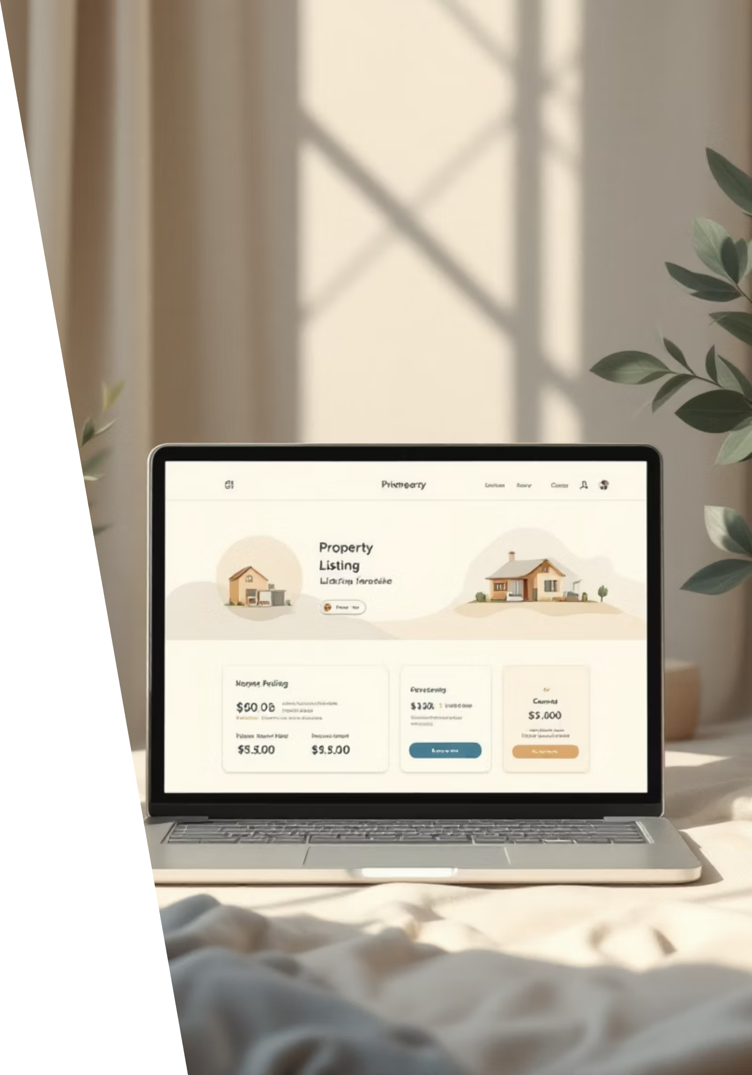
SMART PROPERTY DISCOVERY
FILTER CARD SYSTEM
PROPERTY CARD DISPLAY
Each property page features an intuitive filter card allowing users to refine searches by:
Every property is showcased through a visually appealing property card featuring:
Location and area
Property image and title
Price range
Key specifications (size, price, location)
Property size
Quick highlights and amenities
Amenities and features
Interactive "View Details" button
Availability status
Smart filters ensure users find exactly what they're looking for quickly and efficiently.

Slide 6
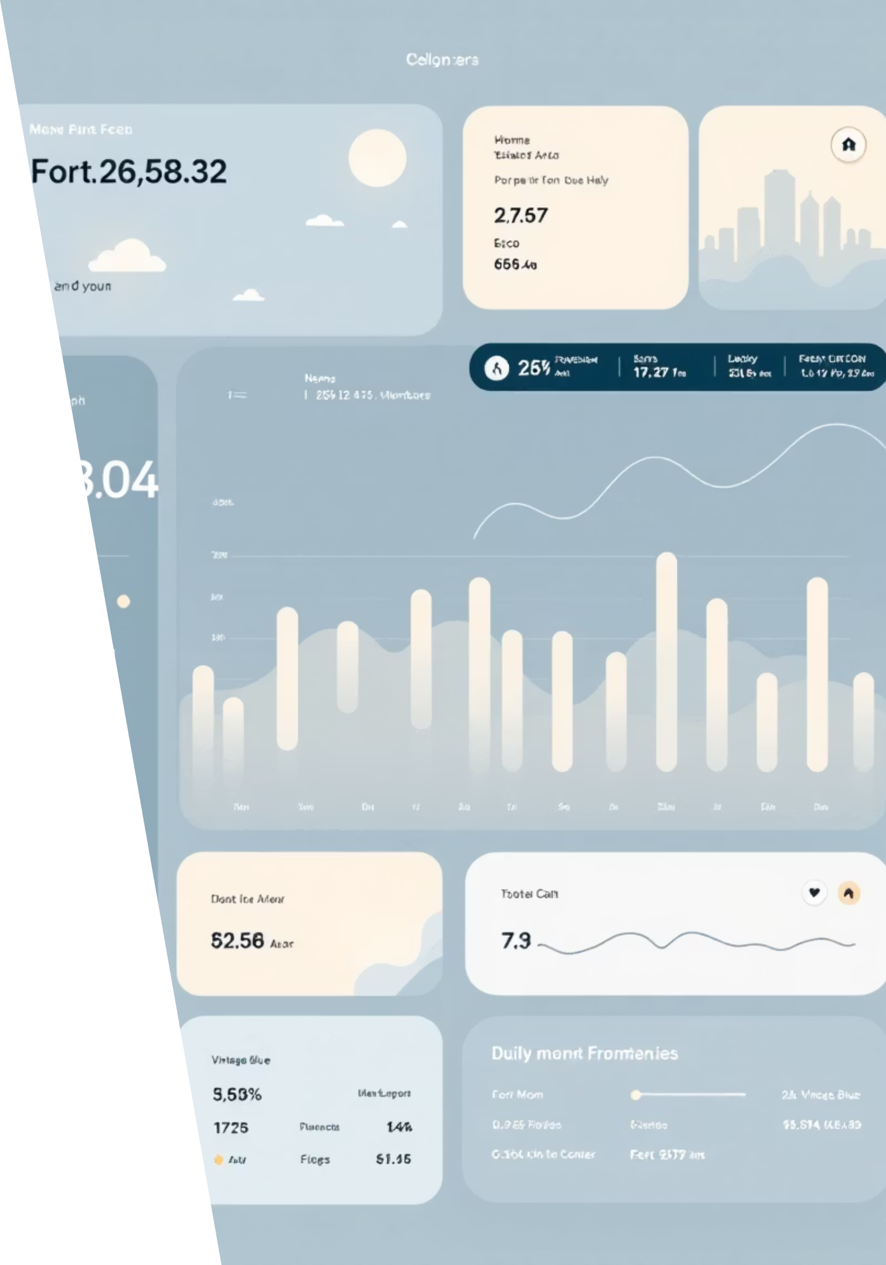


DETAILED PROPERTY VIEW
01
02
BASIC OVERVIEW
VIEW BUTTON
Users see essential information at a glance on the property card - price, location, size, and key features.
Clicking the "View Details" button opens comprehensive property information in an expanded view.
03
Complete Details
Full specifications, multiple images, floor plans, amenities list, neighborhood info, and contact options are displayed.

Slide 7
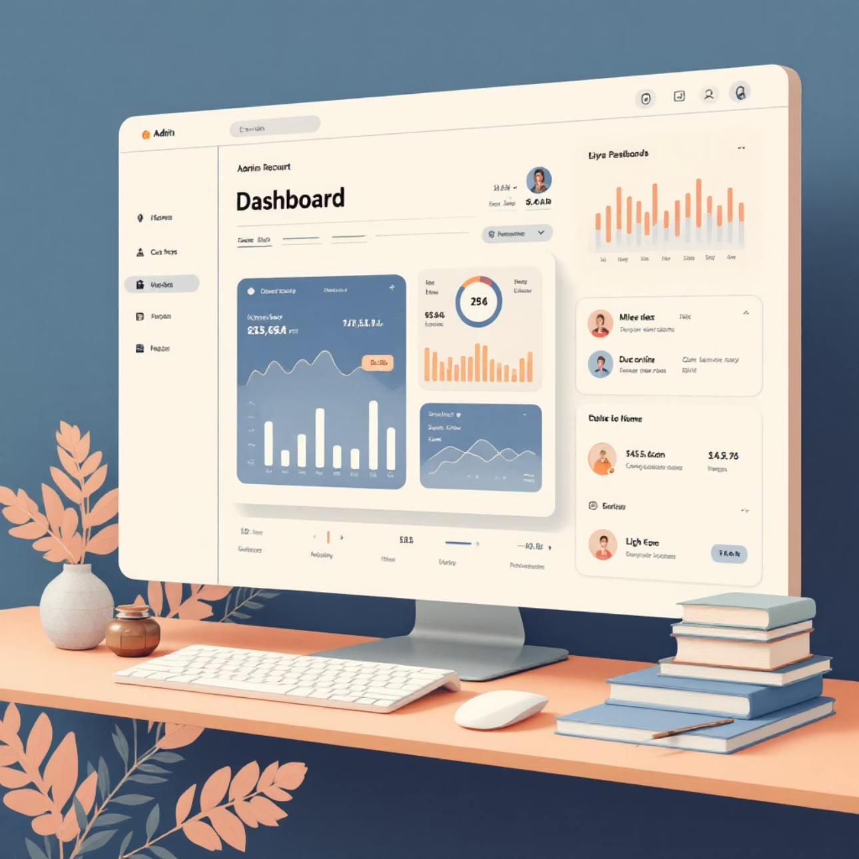
POWERFUL ADMIN PANEL
The KnockTurn admin panel provides complete control over the platform with a user-friendly interface designed for efficiency and ease of management.
CORE ADMIN CAPABILITIES
Add New Listings
Edit Existing Content
Create new property, product, or manpower listings with comprehensive details and media uploads.
Modify and update any listing information, ensuring all content remains current and accurate.
Delete Outdated Items
Remove sold properties, unavailable products, or expired listings to maintain platform quality.

Slide 8

PLATFORM FEATURES & BENEFITS
USER FRIENDLY INTERFACE
Intuitive design makes navigation seamless for both clients and administrators, reducing learning curve and increasing efficiency.
COMPREHENSIVE SEARCH
Advanced filtering and search capabilities help users find exactly what they need across properties, products, and manpower.
REAL TIME UPDATES
Instant synchronization ensures all listings and information remain current across the platform.
SECURE MANAGEMENT
Robust admin controls and security measures protect data and ensure authorized access only.

Slide 9
WHY CHOOSE KNOCKTURN?
3
100%
1
Integrated Services
Digital Solution
Single Dashboard
Property, Project, and Manpower in one unified platform
Fully online management with 24/7 accessibility
Manage everything from one comprehensive admin panel
For Clients
For Administrators
Easy property discovery and comparison
Efficient content management
Detailed information at your fingertips
Quick updates and modifications
Streamlined rental and leasing processes
Comprehensive control over listings
Access to diverse project and service options
Scalable platform for business growth

Slide 10
THANK YOU!
KnockTurn - Connecting Properties, Projects, and Man power
Thank you for exploring our comprehensive platform solution. KnockTurn is committed to revolutionizing how businesses manage their resources through innovative technology and user-centered design.
Project Team: Rebeca Suji A, Durga Devi, Jyothsna Priya
Under the Guidance of: Sam Prakash and Leo Celestine Sir

